Slide 1
CS-513 KNOWLEGDE DISCOVERY AND DATA MINING
Loan Default Risk Assessment

Slide 2




Prepared by:
Pranav Parekh
Siddharth Pansuria
Priyanka Shewale
Aashay Pandya
CWID: 10474370
CWID: 20005837
CWID:10477984
CWID: 10475833

Slide 3
Dataset
Default is the failure to make required interest or principal repayments on a debt, whether that debt is a loan or a security. Default risk is an important consideration for all creditors including banks.
This dataset has been collected from different banks and consists of all the relevant data that a loan borrower must fill before getting a loan approved.
DATASET
Target
The dataset obtained from Kaggle contains 148,670 rows and 34 columns
The classification goal is to predict if the borrower will default on a loan

Slide 4
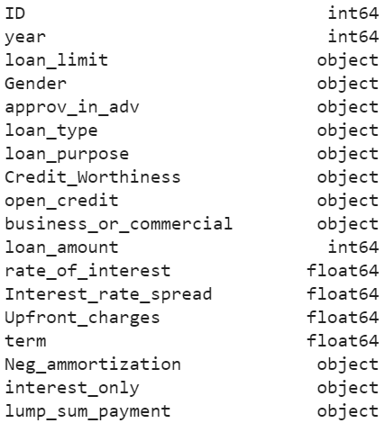
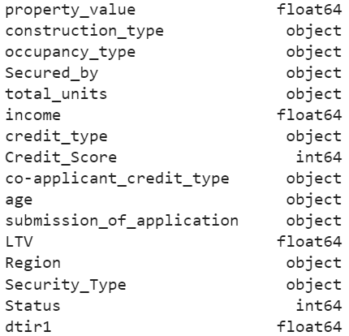
Features
These are the initial 34 features present in the dataset, the object data type here represents strings.
*dtri1 represents debt to income ratio

Slide 5

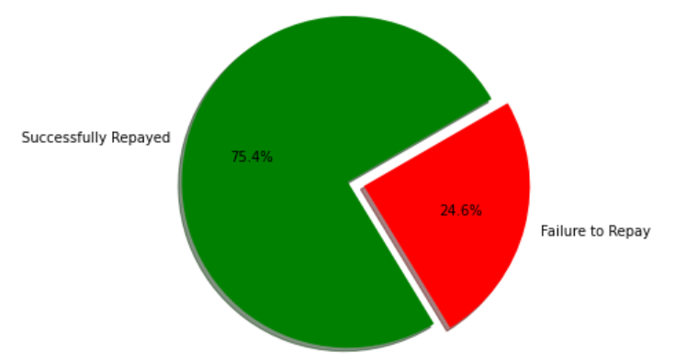
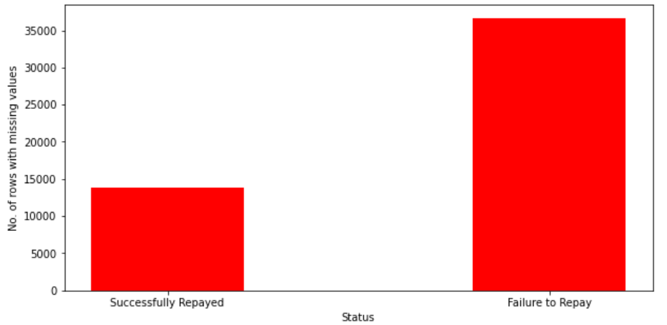
Data Cleaning and Data preprocessing:
On analyzing, we can see that the dataset is imbalanced and there a lot of missing values as well. Before balancing the data, we’ll have to deal with the missing values.
The first instinct would be replacing values with mean, median, or mode, but this might disrupt the relationships between different features. So as a solution we have used MICE to impute missing values.

Slide 6
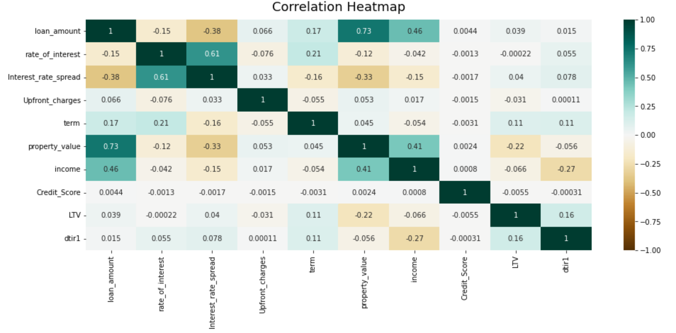
Before imputing missing values, let’s plot the correlation heatmap to check any interesting relationships between columns.

Slide 7
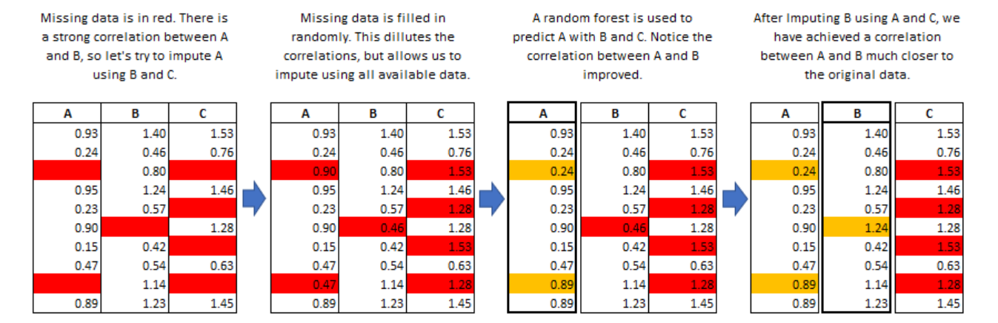
MICE: Multivariate Imputation using Chained equations
The mice package in R, helps you imputing missing values with plausible data values. These plausible values are drawn from a distribution specifically designed for each missing datapoint.
*link to source

Slide 8
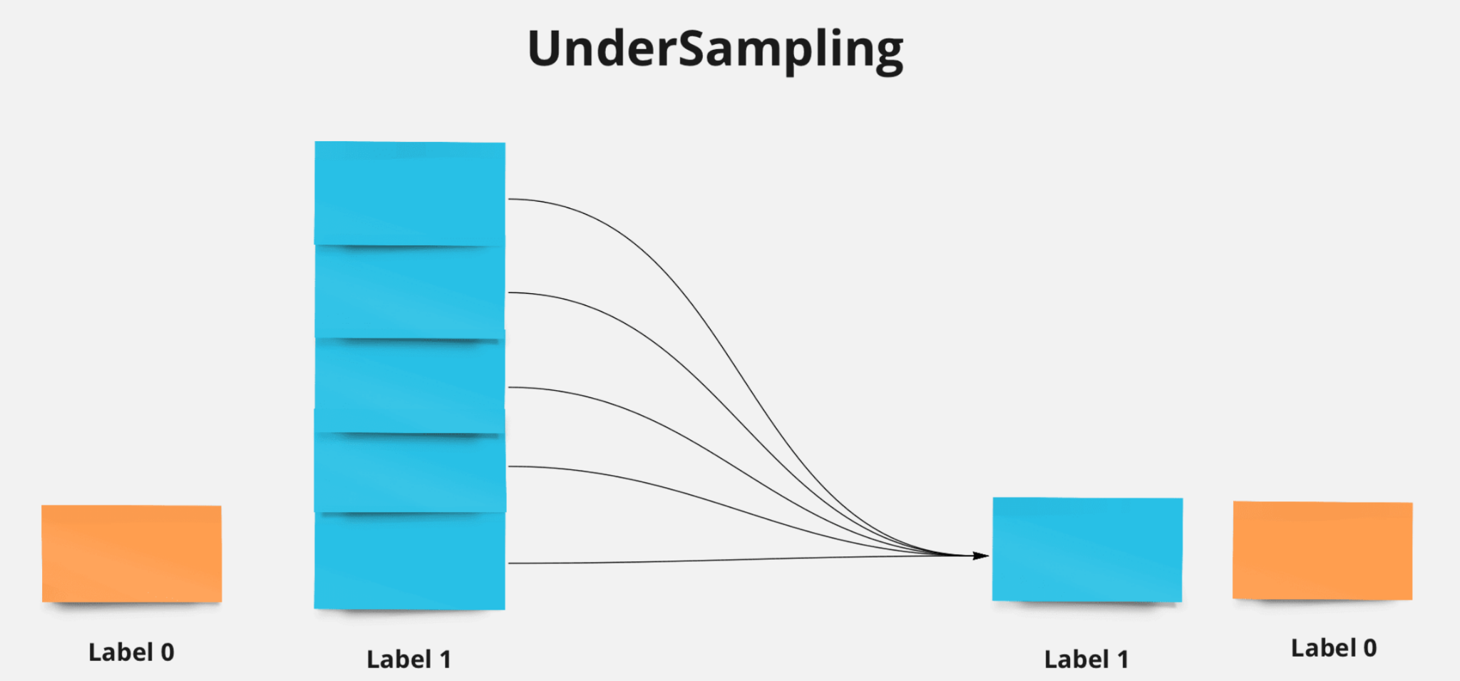
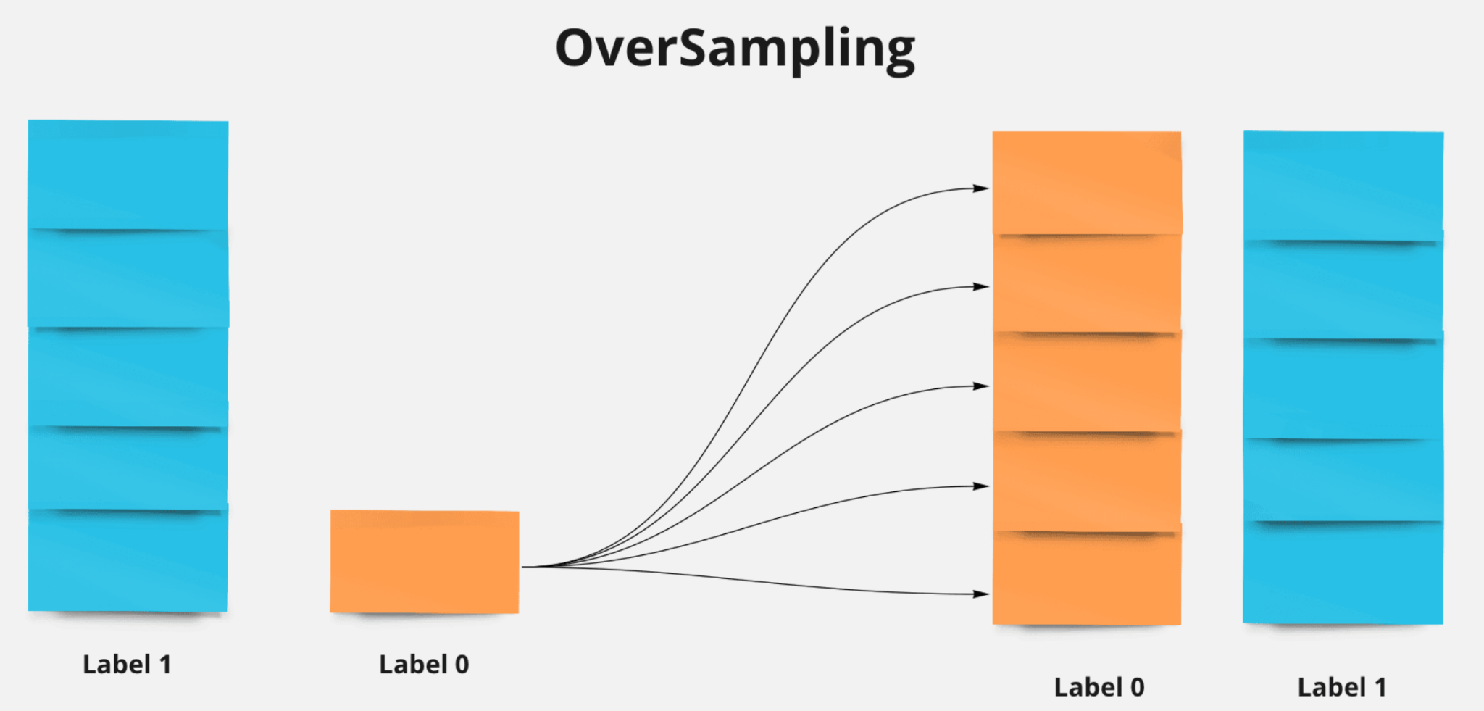
Balancing the data
Balancing can be done in two ways:
Undersampling
Oversampling
For this dataset, we tested both methods, but oversampling gave better results compared to undersampling.
*link to source

Slide 9
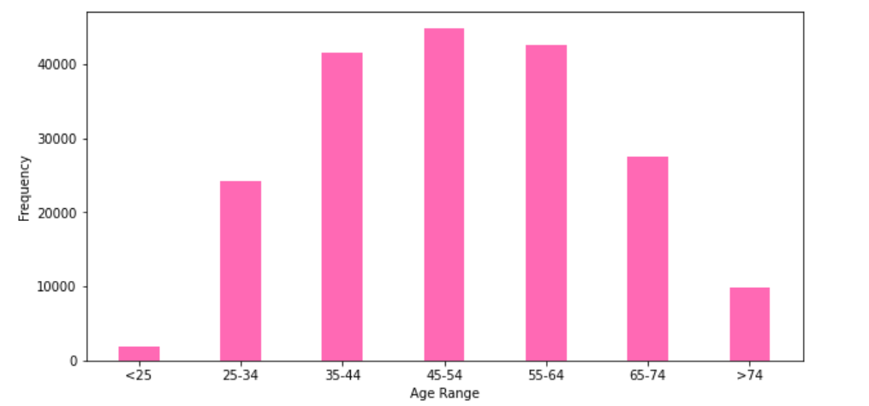
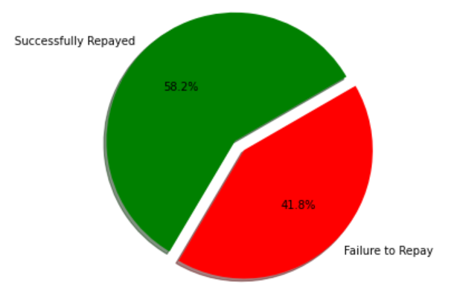
Distribution after preprocessing the data
The final dataset we’ll be working on contains 192,636 rows and 27 features (some monotonic features were dropped).

Slide 10
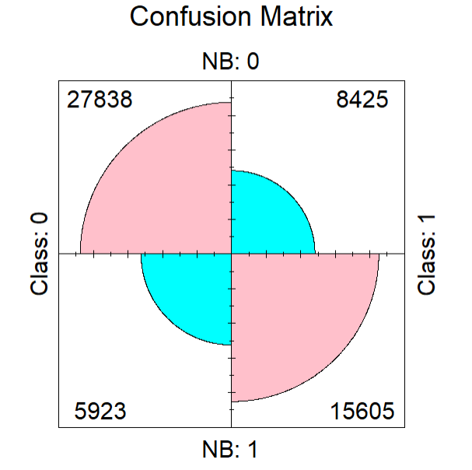
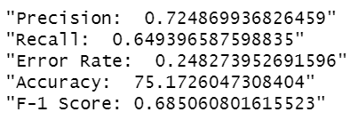
Naïve Bayes
Since Naïve Bayes can handle categorical data, all the columns representing categorical data were convert to factor.
Apart from that, all the numeric values were normalized using Minmax normalization.

Slide 11

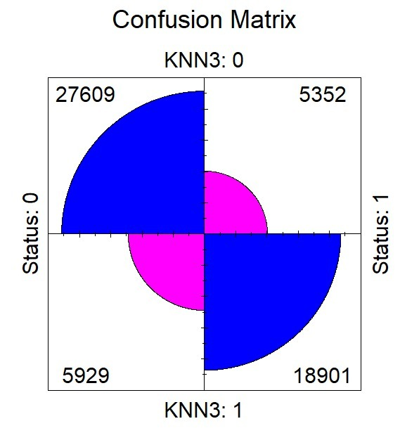
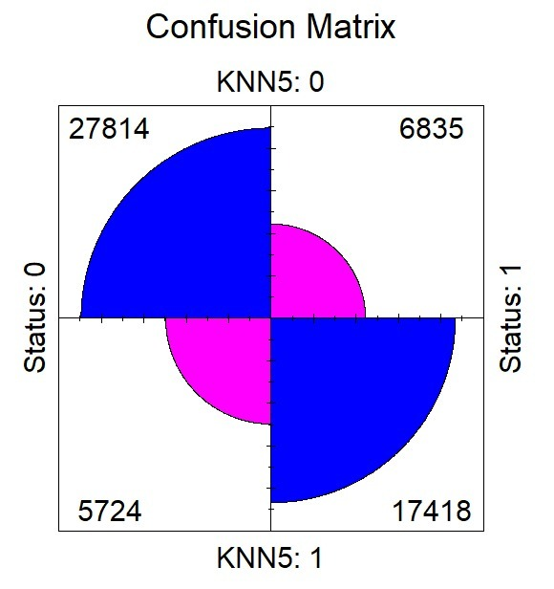


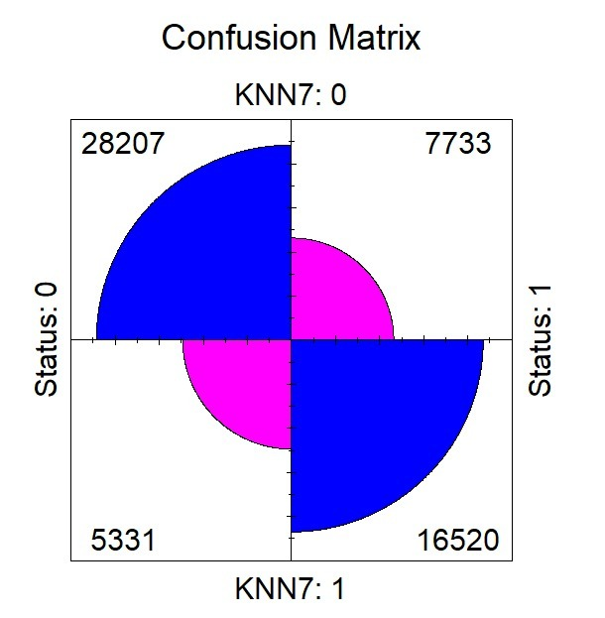
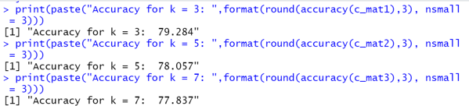
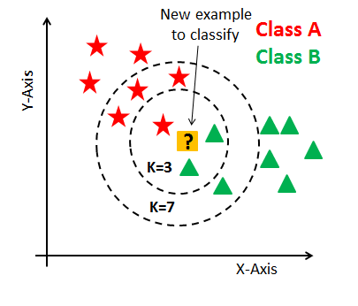
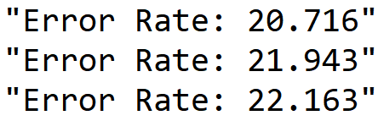

K-Nearest Neighbors
Lazy Learner Algo -> stores dataset and takes action while classification.
Gets input values -> stores -> classifies the data.
K = 3, 5, 7
K = 3
K = 5
K = 7
Notes:
What is the fundamental concept of wisdom of crowds: a large number of uncorrelated models operating as a committee will perform better than individual constituent models. Therefore, a random forest classifier will have a higher accuracy as compared to a decision tree.

Slide 12
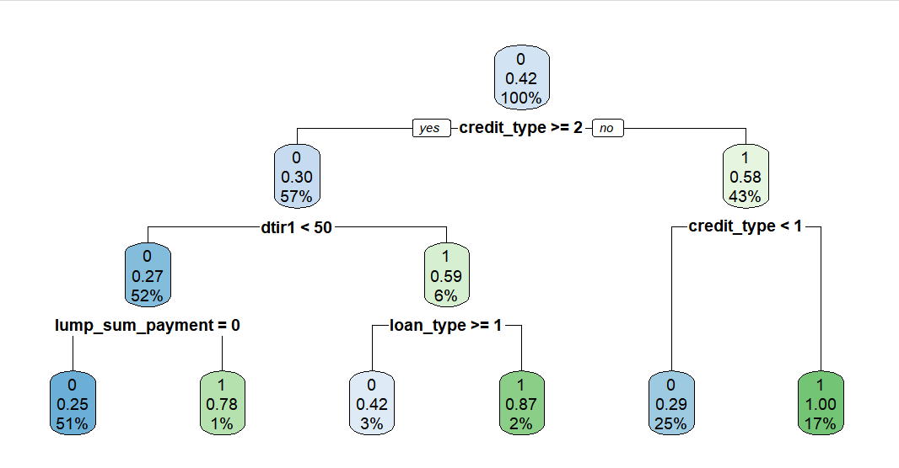
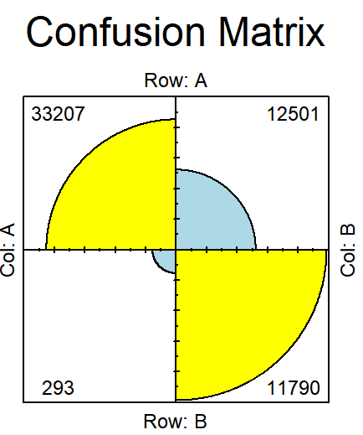
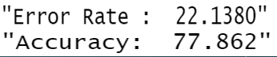
Decision Tree
Works on categorization
GINI Index -> splitting
Predicting the results after categorizing the previous sub related tasks
Top – down approach
Accuracy -> complexity of the tree formed
Rpart -> implementation of CART algorithm (Classification and Regression Tree)
Handles numeric and nominal attributes
Notes:
What is the fundamental concept of wisdom of crowds: a large number of uncorrelated models operating as a committee will perform better than individual constituent models. Therefore, a random forest classifier will have a higher accuracy as compared to a decision tree.

Slide 13
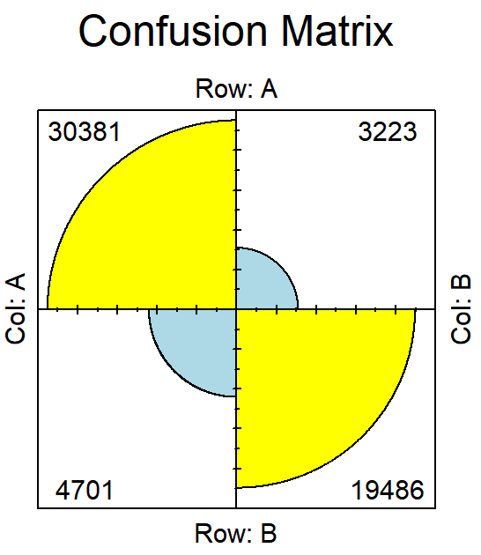
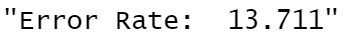
C5.0
Only classification
Binary Tree or Multi branch tree
Uses Information gain -> splitting
Estimates missing values as a function -> other attributes
0 -> completely homogenous
1 -> max amount of disorder
Notes:
What is the fundamental concept of wisdom of crowds: a large number of uncorrelated models operating as a committee will perform better than individual constituent models. Therefore, a random forest classifier will have a higher accuracy as compared to a decision tree.

Slide 14
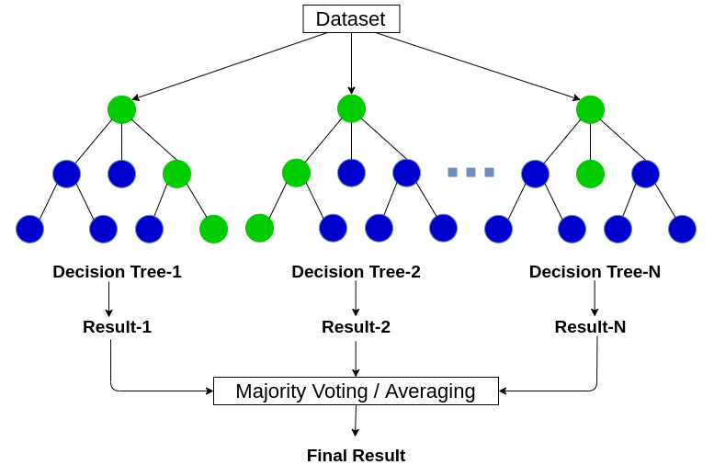
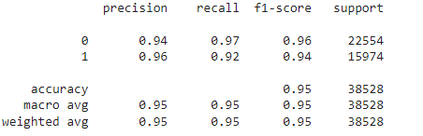
Model: Random forest
Before random forest we deal with categorical variables of age and loan_purpose through one hot encoding.
Random forest classifier consists of many individual trees that operate as an ensemble.
Based on the fundamental concept of wisdom of crowds
Notes:
What is the fundamental concept of wisdom of crowds: a large number of uncorrelated models operating as a committee will perform better than individual constituent models. Therefore, a random forest classifier will have a higher accuracy as compared to a decision tree.

Slide 15
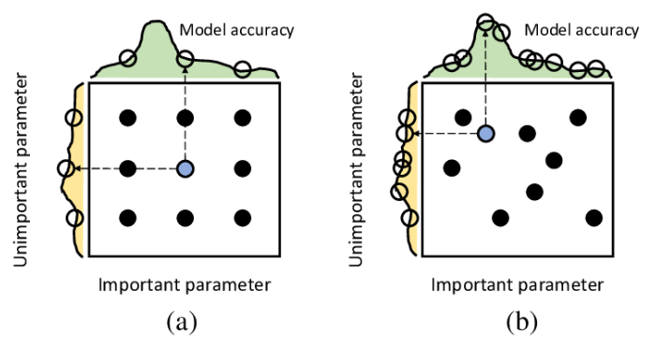
Randomized Search and Grid Search: Used for hyperparameter tuning
We have used Randomized Search alongside random forest, and Grid Search alongside logistic regression

Slide 16
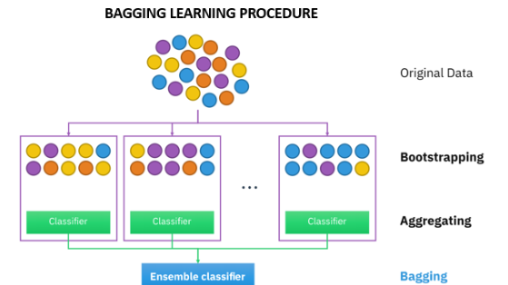
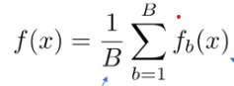
The Concept of bagging
Where, f(x) are the different estimators alongside the base estimators and B is the Bootstrap sample split from the training data

Slide 17
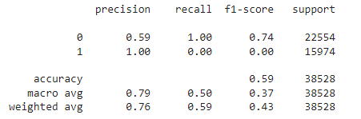
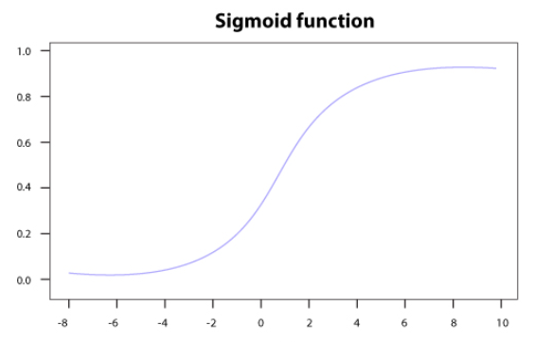
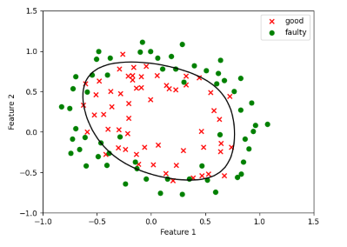
Model: Logistic Regression

Slide 18
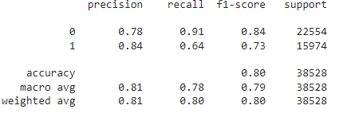
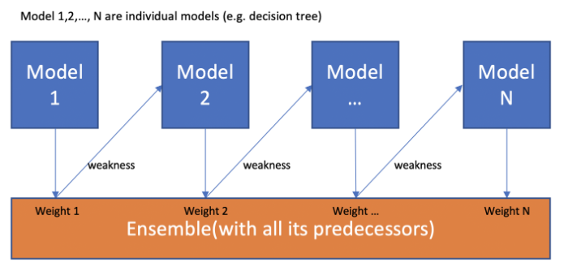
Model: AdaBoost Classifier
An AdaBoost is a sequential ensemble classifier and is a boosting algorithm.
It is highly adaptive in nature.

Slide 19
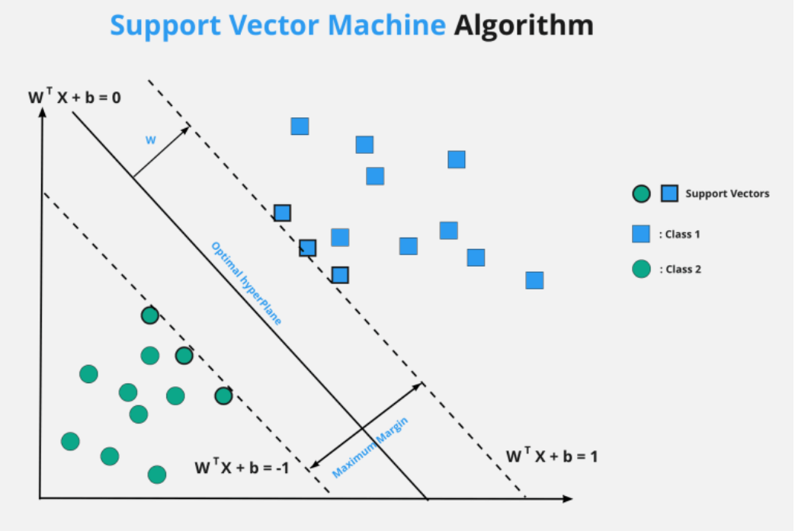
SVM + Grid Search
Objective : Maximize the margin(2w)

Slide 20
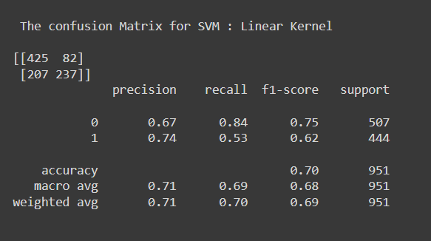
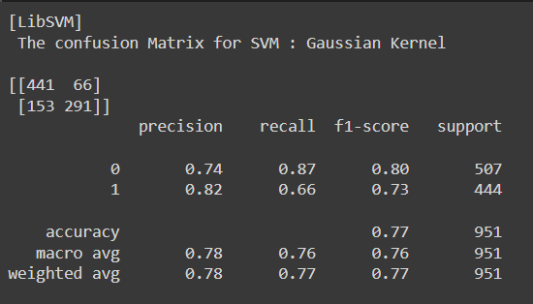
SVM
Linear Kernel:
Gaussian Kernel:

Slide 21
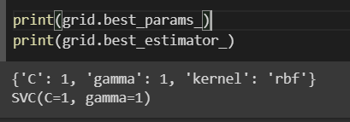
Grid search Parameters

Slide 22
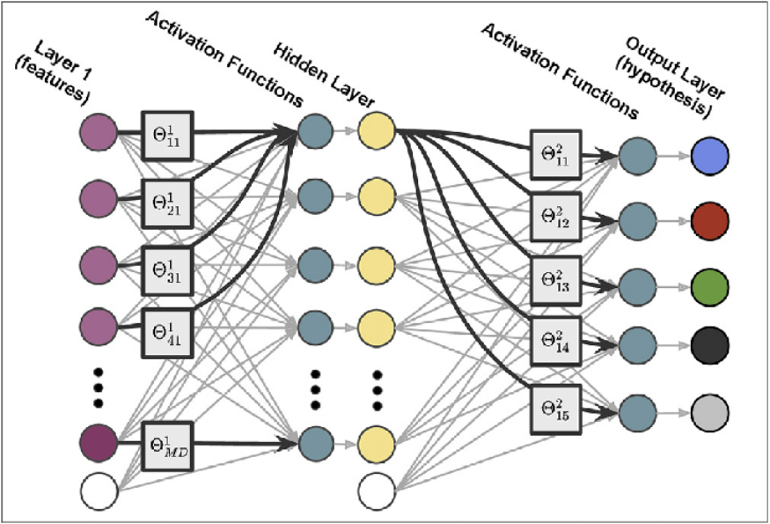
Multilayer Perceptron
Activation Function | Layer
Relu : max(0,val) | Hidden Layer
Sigmoid : [0,1] | Output Layer

Slide 23
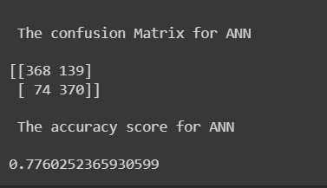
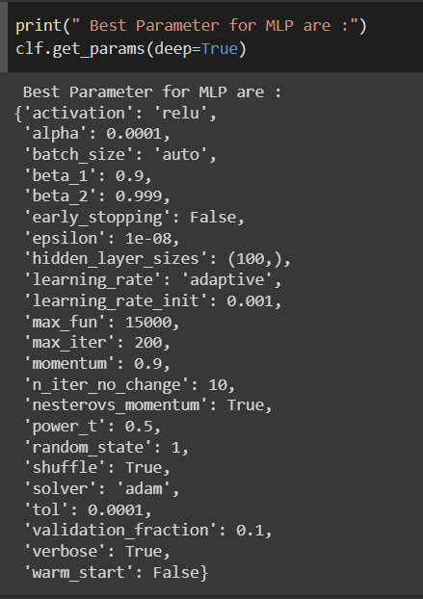
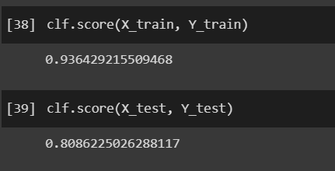
ANN Results :

Slide 24
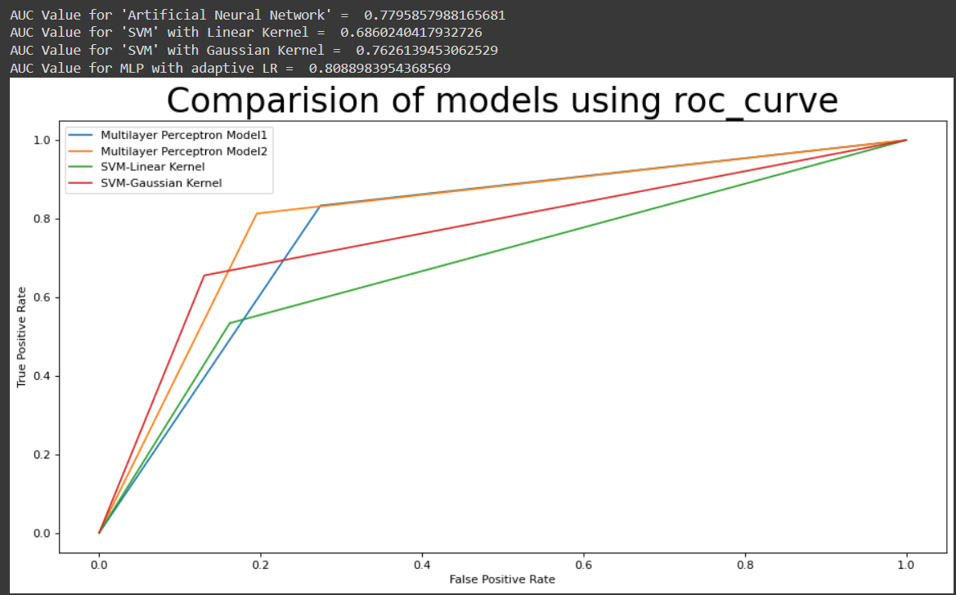
AUC Curve

Slide 26

Thank you

